Slide 1



Computer Interfacing
Sleeping Disorder Monitoring System
GROUP A8
202114006 - Afra Anan
202114016 - Boshita Roy Binti
202114026 - Humayra Akter
202114036 - Maisha Tabassum
202114062 - Mehmil Khan

Slide 2


TODAY’S AGENDA
1
•
•
•
4
INTRODUCTION
RESULT AND DISCUSSION
2
LITERATURE REVIEW
5
FUTURE SCOPES
3
METHODOLOGY
6
REFERENCE

Slide 3

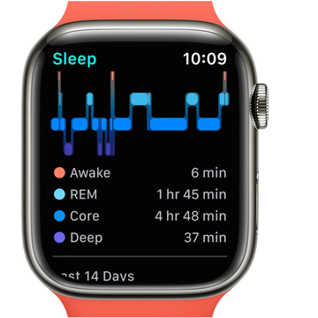
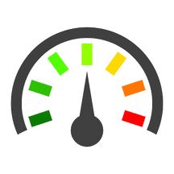
RESEARCH BACKGROUND
Sleep problems are becoming more common, affecting many people and leading to serious health issues like heart disease and anxiety. With the increasing pace of life and stress, understanding sleep patterns is essential for overall well-being. There is a strong need for tools that help people monitor and improve their sleep quality.
Current sleep monitoring methods, like those used in hospitals, are often expensive and not easy to use at home. This limits people’s ability to track their sleep effectively. A more affordable and user-friendly solution can empower individuals to take control of their sleep health in a comfortable setting, leading to improved quality of life.
Accurately tracks sleep quality and stages
Sleep
Track
SIGNIFICANCE
Monitoring important health data like heart
rate and body temperature.

Slide 4




SLEEPING DISORDER MONITORING SYSTEM
The Sleep Disorder Monitoring System is an affordable and user-friendly solution designed to track sleep quality and health metrics like temperature using Arduino technology. By providing real-time data through a mobile app, it empowers users to understand their sleep patterns and make better decisions for their overall well-being.
To build an easy-to-use sleep monitoring system using Arduino.
To provide real-time data through a mobile app
OBJECTIVES
To raise awareness about the importance of good sleep.
To analyze data to evaluate sleep quality

Slide 5
LITERATURE REVIEW
Sleep Tracking: A Systematic Review of Research Using Commercially Available Technology
This study examines the use of popular devices like FitBits and smartphone apps for tracking sleep. It highlights that these technologies are less accurate compared to polysomnography (PSG), which is considered the gold standard. The authors emphasize the need for better validation methods to improve the accuracy of consumer sleep tracking devices
The Promise of Sleep: A Multi-Sensor Approach for Accurate Sleep Stage Detection Using the Oura Ring
This research explores how the Oura Ring combines heart rate and movement data to detect sleep stages. The study reports a 96% accuracy in detecting early waking and a 79% accuracy in identifying deep REM sleep. However, the authors stress the need for testing the technology on larger and more diverse populations
Unobtrusive Sleep Monitoring Using Cardiac, Breathing, and Movements Activities: An Exhaustive Review
This paper reviews sleep monitoring techniques that use heart rate, breathing, and movement data without invasive sensors. While these methods are less accurate than PSG, advancements in machine learning and sensor technology offer hope for better performance in the future

Slide 6
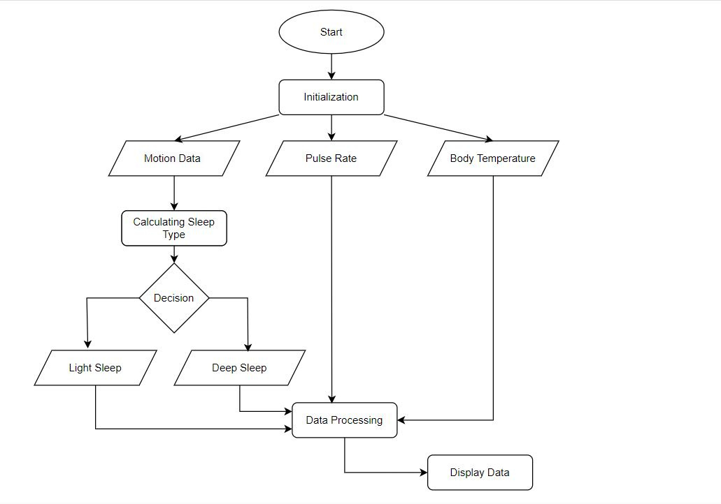
METHODOLOGY
WORK FLOW
DIAGRAM

Slide 7
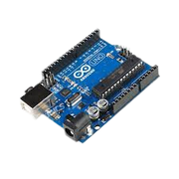
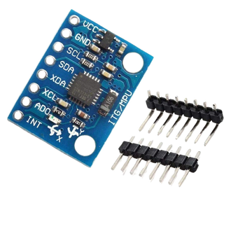
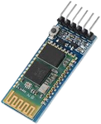
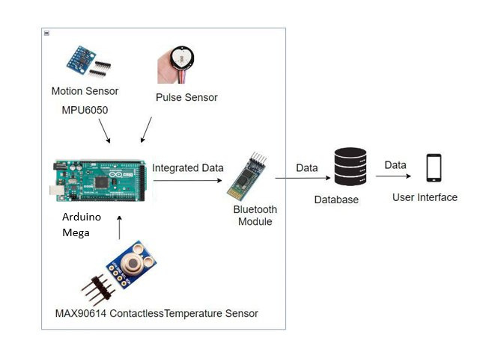
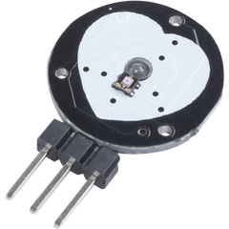
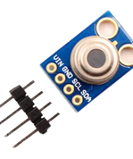



METHODOLOGY
HARDWARE
SYSTEM ARCHITECTURE
Motion Sensor (MPU6050)
Microcontroller: Arduino Mega
Bluetooth Module (HC-05)
Pulse Sensor
Body Temperature Sensor (MAX90614)
SOFTWARE
Arduino IDE
Existing Mobile Application (ArduTooth)

Slide 8
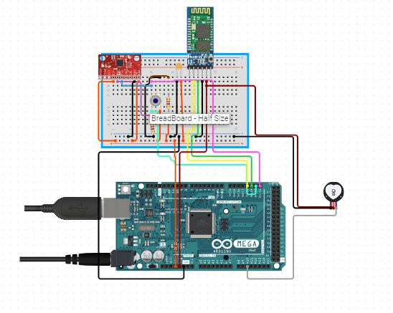
METHODOLOGY
ALGORITHM
1: initialize system();
2: calibrate sensors();
3: gyro data ← read MPU6050();
4: if activate = 0 then
5: if gyro data indicates minimal movement then
6: start sleep timer();
7: if timer ≥5min then
8: activate sleep mode();
9: end if
10: end if
11: else if activate = 1 then
12: light_sleep ← calculate light sleep time();
13: if light_sleep ≥ 1hr 10min then
14: if no interrupt then
15: if light_sleep − interrupt_timer ≥ 5min then
16: deep_sleep ← light_sleep − interrupt_time();
17: end if
18: end if
19: if movement detected then
20: update interrupt timer();
21: if 5 interrupts in 5min then
22: reset sleep mode();
23: end if
24: end if
25: end if
26: delay(1000);
HC-05 ZG (Bluetooth Module)
MPU-6050 (Accelerometer and Gyroscope Sensor)
CIRCUIT DIAGRAM
Pulse Sensor
Arduino Mega

Slide 9

ENVIRONMENT SETUP
IMPLEMENTATION STEPS
Step | Action
1 | Connect motion, pulse, and body temperature sensors to the Arduino UNO.
2 | Install required libraries in the Arduino IDE for each sensor.
3 | Develop and upload the Arduino program for sensor data collection and processing.
4 | Configure the Bluetooth module (HC-05) for wireless communication with the database.
5 | Set up the database to store and manage the incoming sensor data.
6 | Utilize an existing mobile application to display real-time sleep data and notifications.
The system provides real-time data on the user's sleep patterns, ensuring accuracy and reliability.
Users wear motion, pulse, and temperature sensors to collect accurate sleep data throughout the night.
ASSUMPTIONS
CONDITIONS &
CONTROLS
It is designed for adults without severe sleep disorders and may not work accurately for children or those with specific medical conditions.
Sensors need to be calibrated after each use, with regular checks and maintenance to ensure proper functioning.
The system works best in a stable environment without external disturbances that could affect sleep quality.

Slide 10
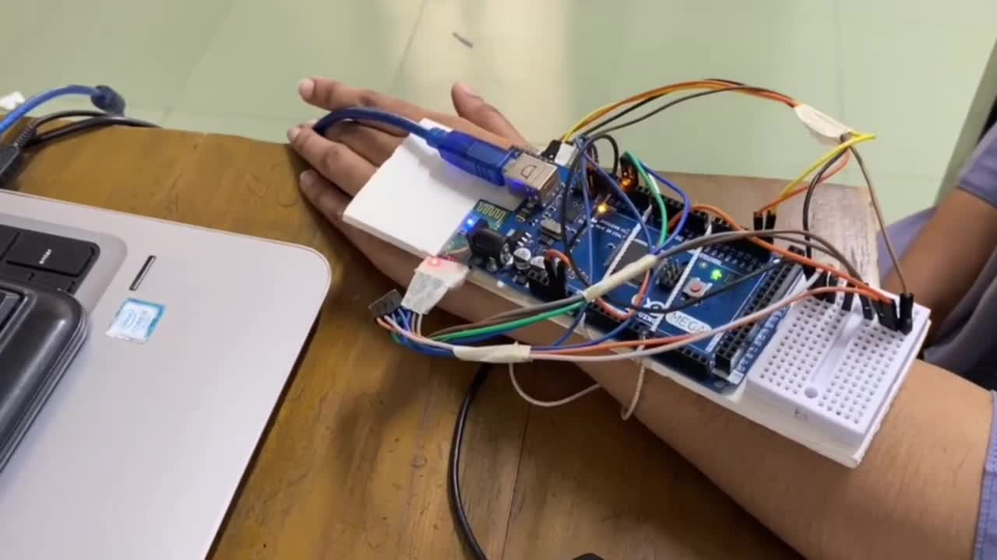
RESULT AND DISCUSSION
VIDEO DEMONSTRATION

Slide 11
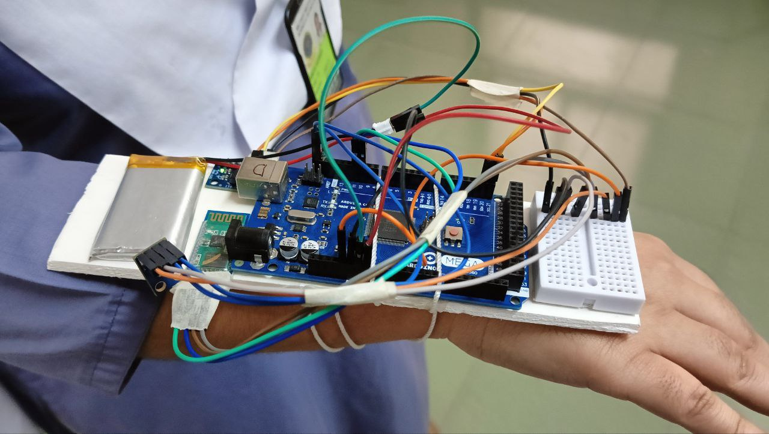
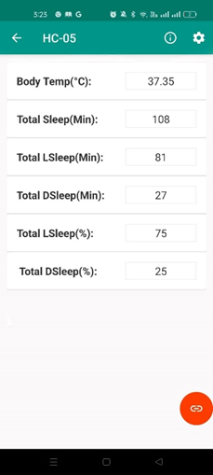

RESULT AND DISCUSSION
Calculating Sleep Patterns

Slide 12


FUTURE SCOPE
Adding better sensors to track more details about sleep, like oxygen levels and brain activity.
Making the sensors more accurate so they can give better sleep stage information.
Creating a simple app that lets users see their sleep data .
Improving the battery life so the device can work longer without needing to be charged.

Slide 13
REFERENCES
[1] Robbins, R., Seixas, A., Walton Masters, L., Chanko, N., Diaby, F., Vieira, D., & Jean-Louis, G. (2019). Sleep Tracking: A Systematic Review of the Research Using Commercially Available Technology. Current Sleep Medicine Reports, 5(3), 156-163. https://doi.org/10.1007/s40675-019-00150-1
[2] Altini, M., & Kinnunen, H. (2021). The Promise of Sleep: A Multi-Sensor Approach for Accurate Sleep Stage Detection Using the Oura Ring. Sensors, 21(13), 4302. https://doi.org/10.3390/s21134302
[3] Matar, G., Lina, J.-M., Carrier, J., & Kaddoum, G. (2018). Unobtrusive Sleep Monitoring Using Cardiac, Breathing, and Movements Activities: An Exhaustive Review. IEEE Access, 6, 45129-45150. https://doi.org/10.1109/ACCESS.2018.2865487

Slide 14

Open Forum

